Slide 2
Communication with Principal Investigators (and others)
It Is All in the Translation
Sandy Fowler, Assistant Dean for Research
College of Agricultural and Life Sciences

Slide 3
Disclosure
I’m no expert
I communicate like people can read my mind – and get frustrated when they don’t understand me!
Always practicing patience.
I prefer written communication over the spoken word.
I’m an advocating communicator – more about this.
Only an hour to share – high level.
Participation expected today – expectations are communicated!

Slide 4
Active listening
Verbal
Lots out there about it.
Communication skill.
Shows the speaker you are listening.
  eye contact, paraphrasing, listen for understanding, withhold judgement
Does it give the listener what they need?
One sided if the speaker doesn’t partake.
Listener really “hearing”?

Slide 5
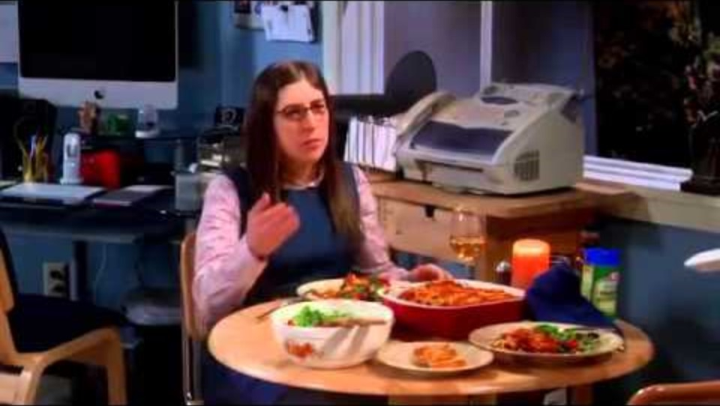
Active listening

Slide 6
Perceptive Communication
Not about personalities or behaviors
Need to evaluate self in the communication exchange – tough!
About communication needs that lead to trust
Using perceptual skills to understand and adapt to a listener
Breaks down into four styles
  Controlling – not in a bad way
  Analyzing
  Advocating
  Facilitating
Scales of signals: Assertive, Receptive, Reserved, Responsive

Slide 7
Perceptive Communication
Controlling
  Task/goal oriented, discipline, competitive, efficient, organized
Analyzing
  Detailed oriented, precise, rational, inquisitive, logical
Advocating
  Idea oriented, creative, enthusiastic, personable, expressive
Facilitating
  People oriented, loyal, team player, cooperative, helpful, empathetic

Slide 8
Perceptive Communication
Assertive and receptive signaling
  Authority one tends to show
  Appears confidence vs unsure
  Fast talk vs slow talk
Reserved and responsive signaling
  The emotion or feeling one shows or doesn’t
  Formal vs informal
  Withholds feelings vs shows feelings
  Structured vs spontaneous

Slide 9
Perceptive Communication – Mapping
Reserved
Controlling
Analyzing
Advocating
Facilitating
Assertive
Receptive
Responsive

Slide 10
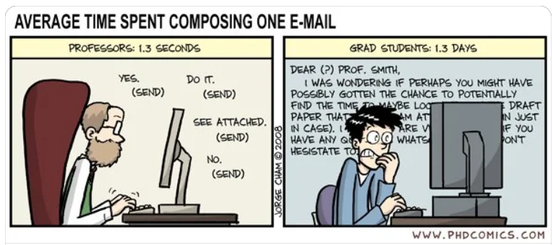

Slide 11
The PI’s and Research Administrator’s Perspective
We all have a common goal.
Knowledge bases are different.
  Faculty don’t normally speak RA, finance, or accounting
Not behind the desk.
  Has other roles and responsibilities.
  In the field, doing medical rounds, in surgery, advising students.
Human perspective.
  We all could have something else going on

Slide 12
Resources
Perceptive Communication – Erickson & Company
Harvard Business Review – What Is Active Listening, https://hbr.org/2024/01/what-is-active-listening
Verywellmind.com – 7 Active Listening Techniques for Better Communication, https://www.verywellmind.com/what-is-active-listening-3024343

